Slide 1

Introduction to PsychToolbox in MATLAB
Psych 599, Summer 2013
Jonas Kaplan, Ph.D.
University of Southern California
Week 2

Slide 2
Week 1 Recap

Slide 3



“Do you want to go out in style or do you want to go out in one piece? Now come on, let’s get out of here, let’s go back to the old gym, will ya, lets get some blood and sweat and tears around here, can we do that??”

Slide 4
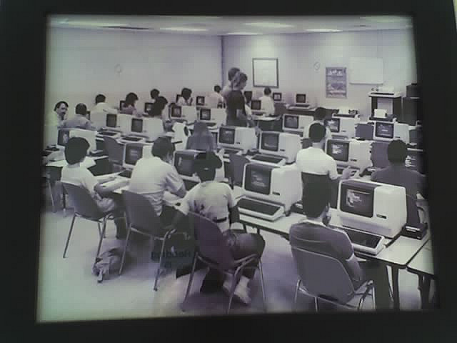

Slide 5
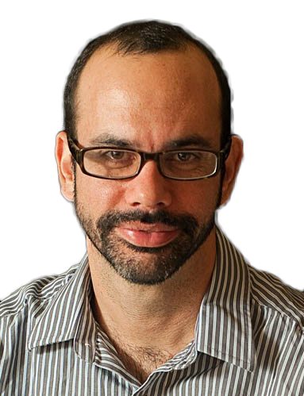


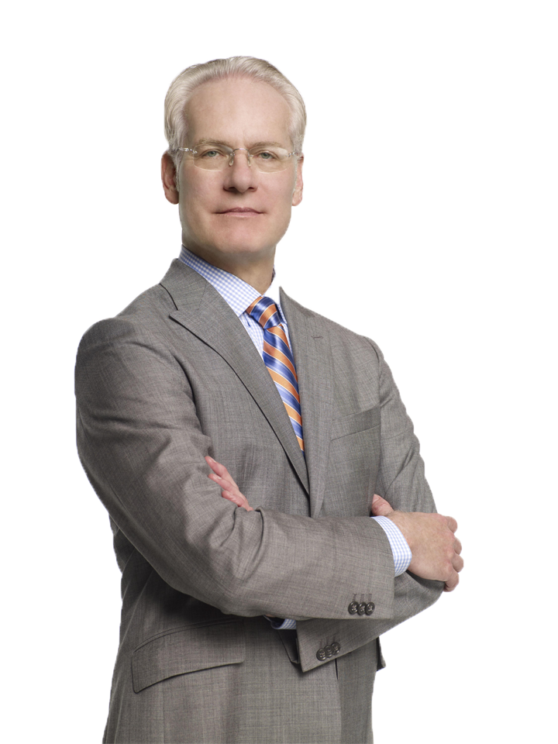
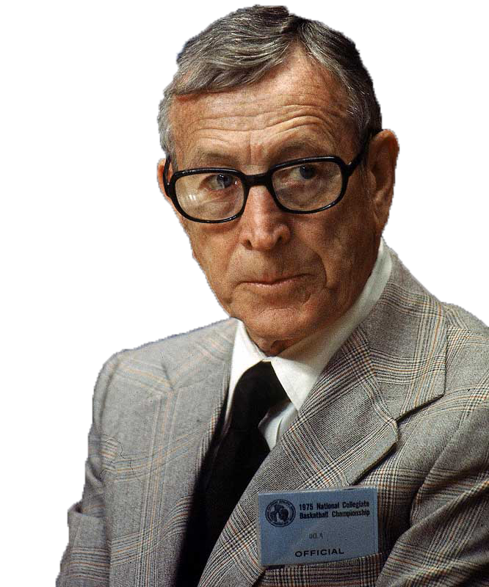
If you don't have time to do it right, when will you have time to do it over?
Make it work!

Slide 6
Vectors and matrices
Vectors are like lists a = [1,2,3,4,5]
Matrices are like lists of lists a = [ 1,3,5,7; 2,4,6,8 ]
Matrices can have many dimensions

Slide 7
Accessing elements
>> a = [0:4]
a =
0 1 2 3 4
>> a(2)
ans =
1
>> b = [1,2,3;4,5,6;7,8,9]
b =
1 2 3
4 5 6
7 8 9
>> b(2,3)
ans =
6

Slide 8
Accessing elements
>> b(1:3,1)
ans =
1
4
7
>> b(1,:)
ans =
1 2 3

Slide 9
Accessing elements
>> a = [1:.5:5];
>> a([1 2 4])
ans =
1.0000 1.5000 2.5000
>> indices = [5 6 7];
>> a(indices)
ans =
3.0000 3.5000 4.0000
>> a([5 6 7])
ans =
3.0000 3.5000 4.0000
equivalent

Slide 10
Accessing elements
>> odds = [1:2:100];
>> odds([26:50, 1:25])
ans =
Columns 1 through 14
51 53 55 57 59 61 63 65 67 69 71 73 75 77
Columns 15 through 28
79 81 83 85 87 89 91 93 95 97 99 1 3 5
Columns 29 through 42
7 9 11 13 15 17 19 21 23 25 27 29 31 33
Columns 43 through 50
35 37 39 41 43 45 47 49

Slide 11
Accessing elements
>> [26:50,1:25]
ans =
Columns 1 through 14
26 27 28 29 30 31 32 33 34 35 36 37 38 39
Columns 15 through 28
40 41 42 43 44 45 46 47 48 49 50 1 2 3
Columns 29 through 42
4 5 6 7 8 9 10 11 12 13 14 15 16 17
Columns 43 through 50
18 19 20 21 22 23 24 25

Slide 12
Working with strings
Strings in Matlab are vectors of characters
Always use single quotes to define strings
>> name = 'Jonas'
name =
Jonas
>> name(1)
ans =
J
>> name(1:3)
ans =
Jon

Slide 13
Formatting strings
>> employee = 'Fred';
>> age = 32;
>> score = 88.432;
>> fprintf('Employee: %s is %d years old and scored %f',employee,age,score);
Employee: Fred is 32 years old and scored 88.432000>>
These symbols that start with % are substitution points (‘conversion characters’). Matlab will insert the subsequent variables into the text, in order. The number of variables listed must match the number of conversion characters.
%s string
%d integer/digit
%i integer/digit
%f floating point number
%c single character

Slide 14
Working with numbers in strings
>> fprintf('Score: %f\n',score);
Score: 88.432000
>> fprintf('Score: %.2f\n',score);
Score: 88.43
>> fprintf('Score: %.0f\n',score);
Score: 88
>> fprintf('Score: %.5f\n',score);
Score: 88.43200
Specifies the number of decimal places in a floating point number
>> fprintf('Age: %d\n',age)
Age: 32
>> fprintf('Age: %.4d\n',age)
Age: 0032
Or the number of total digits in an integer

Slide 15
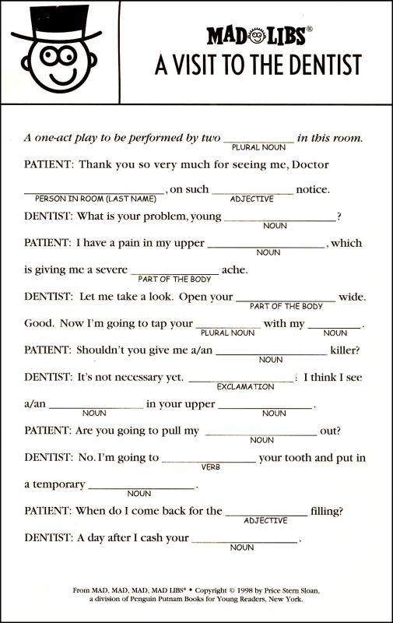

Slide 16
Formatting strings
>> employee = 'Fred';
>> age = 32;
>> score = 88.432;
>> fprintf('Employee: %s is %d years old and scored %f',employee,age,score);
Employee: Fred is 32 years old and scored 88.432000>>
These symbols that start with % are substitution points (‘conversion characters’). Matlab will insert the subsequent variables into the text, in order. The number of variables listed must match the number of conversion characters.
%s string
%d integer/digit
%i integer/digit
%f floating point number
%c single character

Slide 17
Creating string variables
>> subject = 'SXF32';
>> logfileName = sprintf('data_%s.txt',subject);
>> logfileName
logfileName =
data_SXF32.txt
Make your variable names as informative as possible. Someone reading your code should know what a variable contains by looking at its name. That person might be Future You or a colleague.

Slide 19


Using cell arrays
>> mycell = {'hello',4,'goodbye',543.43}
mycell =
'hello' [4] 'goodbye' [543.4300]
>> mycell = {[1:5],[6:10]}
mycell =
[1x5 double] [1x5 double]
>> mycell(1)
ans =
[1x5 double]
>> mycell{1}
ans =
1 2 3 4 5
access the cells themselves
access the contents of the cells

Slide 20
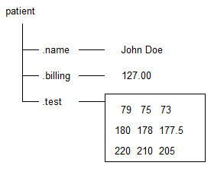
Structures
Structures can be used to organize and group information
>> patient.name = 'John Doe';
>> patient.billing = 127.00;
>> patient.test = [79, 75, 73; 180, 178, 177.5; 220, 210, 205];
>> patient
patient =
name: 'John Doe'
billing: 127
test: [3x3 double]

Slide 21
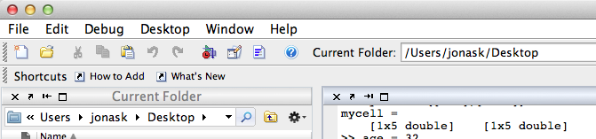
Creating a script
create new blank document

Slide 22
Your first script
% My first script
x = 5;
y = 6;
z = x + y
Save script as “myFirst.m”
EDITOR
>> myFirst
z =
11
COMMAND WINDOW

Slide 23
COMMAND WINDOW versus EDITOR

Slide 24
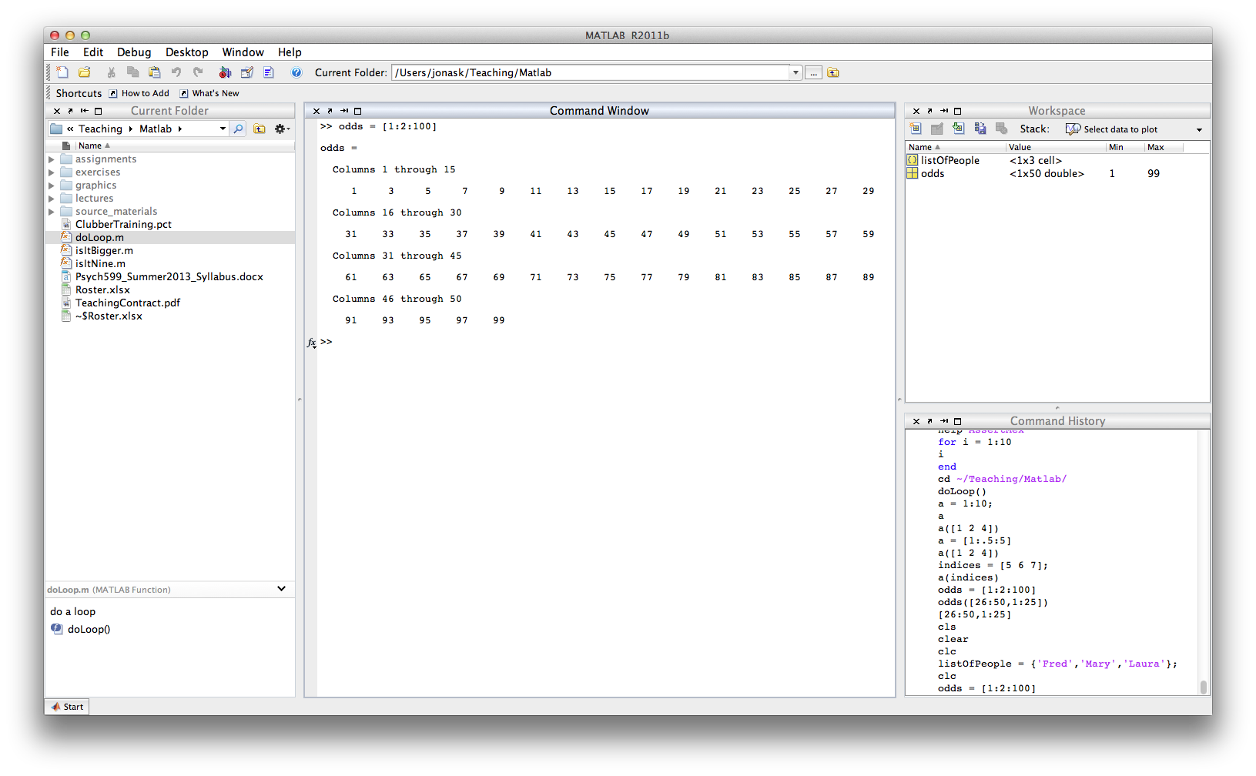
Command window
Commands are executed immediately when you press Return
Variables that are created appear in the Workspace
Cannot define functions here

Slide 25
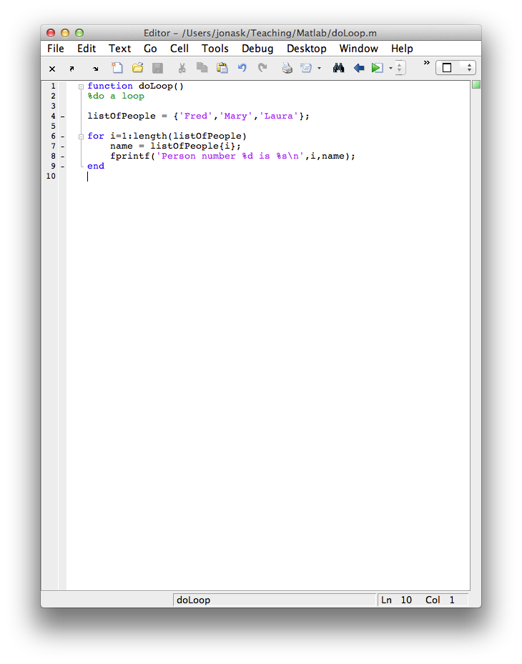
Editor
Commands are not executed right away*. They will only be executed when you invoke the saved file from the Command Window. When you do that, everything in the file will be executed, in order.
Variables created here will not appear in the Workspace
You may define functions here
* if you want one or more lines from a file in the Editor to be executed immediately, you can do that:
Highlight the part you want to execute
Text menu -> Evaluate selection….
or press Shift + F7 (on mac)

Slide 26
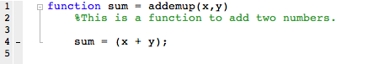
Function declarations
All functions must be declared, that is, introduced in the proper way.
code folding
result of the function
name of the function
parameters passed to the function
OUT
IN

Slide 27


Coding style
ist= 10;
sst= 4;
r= [1,2];
ist = ist/fr;
sst = sst/fr;
%set up standard presentation parameters
instructionScreenTime = 10; %how long the instructions will stay on, in seconds
stimulusScreenTime = 4; %how long the stimulus will stay on, in seconds
acceptableResponses = [1,2]; %which responses buttons the subject may press
%convert times from seconds into frames
instructionScreenTime = instructionScreenTime/frameRate;
stimulusScreenTime = stimulusScreenTime/frameRate;

Slide 28
Week #1 assignment
Write a function named “yourInitials_week1()”
The function should take two inputs: 1) a string containing the subject’s code 2) a vector of 5 scores
The function should return two values: 1) the mean of the 5 scores, after removing the lowest one 2) the standard error of the mean of the 5 scores after removing the lowest one
The function should also do the following when run: 1) print the following line to the screen: “Working on subject XXXX…” where XXXX is the subject code 2) plot a bar graph with the 5 scores

Slide 29
Week #1 Assignment
function [meanOfScores,semOfScores] = JTK_week1(code,scores)
%
% This function will return the mean and standard deviation of a set of
% scores after removing the lowest score. It will also plot a bar graph of
% all of the scores.
%
% [meanOfScores,semOfScores] = JTK_week1(code,scores)
%
% where code is a string referring to the subject and scores is a vector of
% 5 scores
fprintf('Working on subject %s...\n',code);
sortedScores = sort(scores); %sort the scores in order
cleanedScores = sortedScores(2:end); %remove the lowest score
meanOfScores = mean(cleanedScores); %get mean of cleaned scores
semOfScores = std(cleanedScores)/sqrt(length(cleanedScores)); %get standard error of cleaned scores
bar(scores); %plot scores in bar graph
end

Slide 30
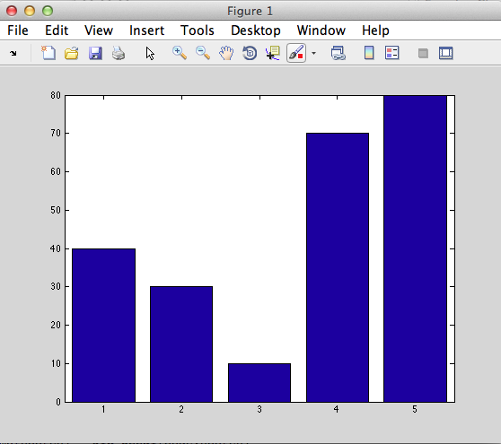
Week #1 Assignment
>> help JTK_week1
This function will return the mean and standard deviation of a set of
scores after removing the lowest score. It will also plot a bar graph of
all of the scores.
[meanOfScores,semOfScores] = JTK_week1(code,scores)
where code is a string referring to the subject and scores is a vector of
5 scores
>> [avg, stderr] = JTK_week1(‘SX01’,[40,30,10,70,80]);
Working on subject SX01...
>> avg
avg =
55
>> stderr
stderr =
11.9024

Slide 31
>> scores = [40,30,10,70,80];
>> scores = sort(scores)
scores =
10 30 40 70 80
>> scores = scores(2:end)
scores =
30 40 70 80
>> N = length(scores);
>> sem = std(scores)/sqrt(N);
>>
>> sem = std(scores)/sqrt(length(scores));

Slide 33
Additional resources
Class website discussion board
Online tutorials and Matlab classes from other universities on the class website

Slide 34
Finding values within a matrix
>> x = rand(1,5)
x =
Columns 1 through 8
0.7060 0.0318 0.2769 0.0462 0.0971 0.8235 0.6948 0.3171
Columns 9 through 10
0.9502 0.0344
>> find(x>.5)
ans =
1 6 7 9

Slide 35
Finding values within a matrix
>> indicesWhereBig = find(x>.5)
indicesWhereBig =
1 6 7 9
>> x(indicesWhereBig)
ans =
0.7060 0.8235 0.6948 0.9502
>> x(find(x>.5))
ans =
0.7060 0.8235 0.6948 0.9502

Slide 36
Logical indexing
>> x>.5
ans =
1 0 0 0 0 1 1 0 1 0
>> vec = ans;
>> whos vec
Name Size Bytes Class Attributes
vec 1x10 10 logical
>> x(vec)
ans =
0.7060 0.8235 0.6948 0.9502
>> x(x>.5)
ans =
0.7060 0.8235 0.6948 0.9502
equivalent to
x(find(x>.5))

Slide 37
Logical indexing
>> newvec = [1 0 0 0 0 1 1 0 1 0]
newvec =
1 0 0 0 0 1 1 0 1 0
>> whos newvec
Name Size Bytes Class Attributes
newvec 1x10 80 double
>> x(numvec)
Subscript indices must either be real positive integers or logicals.
>> numvec = logical(numvec);
>> x(numvec)
ans =
0.7060 0.8235 0.6948 0.9502

Slide 38
Logical indexing
>> x = [1:100];
>> x(x<=23)
ans =
Columns 1 through 14
1 2 3 4 5 6 7 8 9 10 11 12 13 14
Columns 15 through 23
15 16 17 18 19 20 21 22 23
>> x = [1:10];
>> x(x<5) = 0
x =
0 0 0 0 5 6 7 8 9 10

Slide 39

Getting the truth

Slide 40
Getting the truth
Often, we want to test whether a certain condition is true or not.
To do this we use special operators that describe relationships among entities, called relational operators

Slide 41
Getting the truth
== equal to (distinguish from = which sets a value)
~= not equal to
> greater than
< less than
>= greater than or equal to
<= less than or equal to

Slide 42
>> 1 == 2
ans =
0
>> 1 < 2
ans =
1
>> 1 = 2
1 = 2
|
Error: The expression to the left of the equals sign is not a valid target for an
assignment.
>> x = 5;
>> x < 100
ans =
1
0 means FALSE
1 means TRUE

Slide 43
Testing the truth
Logical operators:
& AND (sometimes you will see &&)
| OR (sometimes you will see ||)
~ NOT

Slide 44
>> x = 5; y = 1;
>> x > 4 & y > 4
ans =
0
>> (x>4) & (y>4)
ans =
0
>> (x>4) | (y>4)
ans =
1
>> (y>4)
ans =
0
>> ~(y>4)
ans =
1

Slide 45
Comparing strings
>> x = 'hello';
>> y= 'goodbye';
>> x == y
Error using ==
Matrix dimensions must agree.
>> help strcmp
strcmp Compare strings.
TF = strcmp(S1,S2) compares the strings S1 and S2 and returns logical 1
(true) if they are identical, and returns logical 0 (false) otherwise.
>> strcmp(x,y)
ans =
0
>> y = ‘Hello’;
>> strcmp(x,y)
ans =
0
>> strcmpi(x,y)
ans =
1

Slide 46
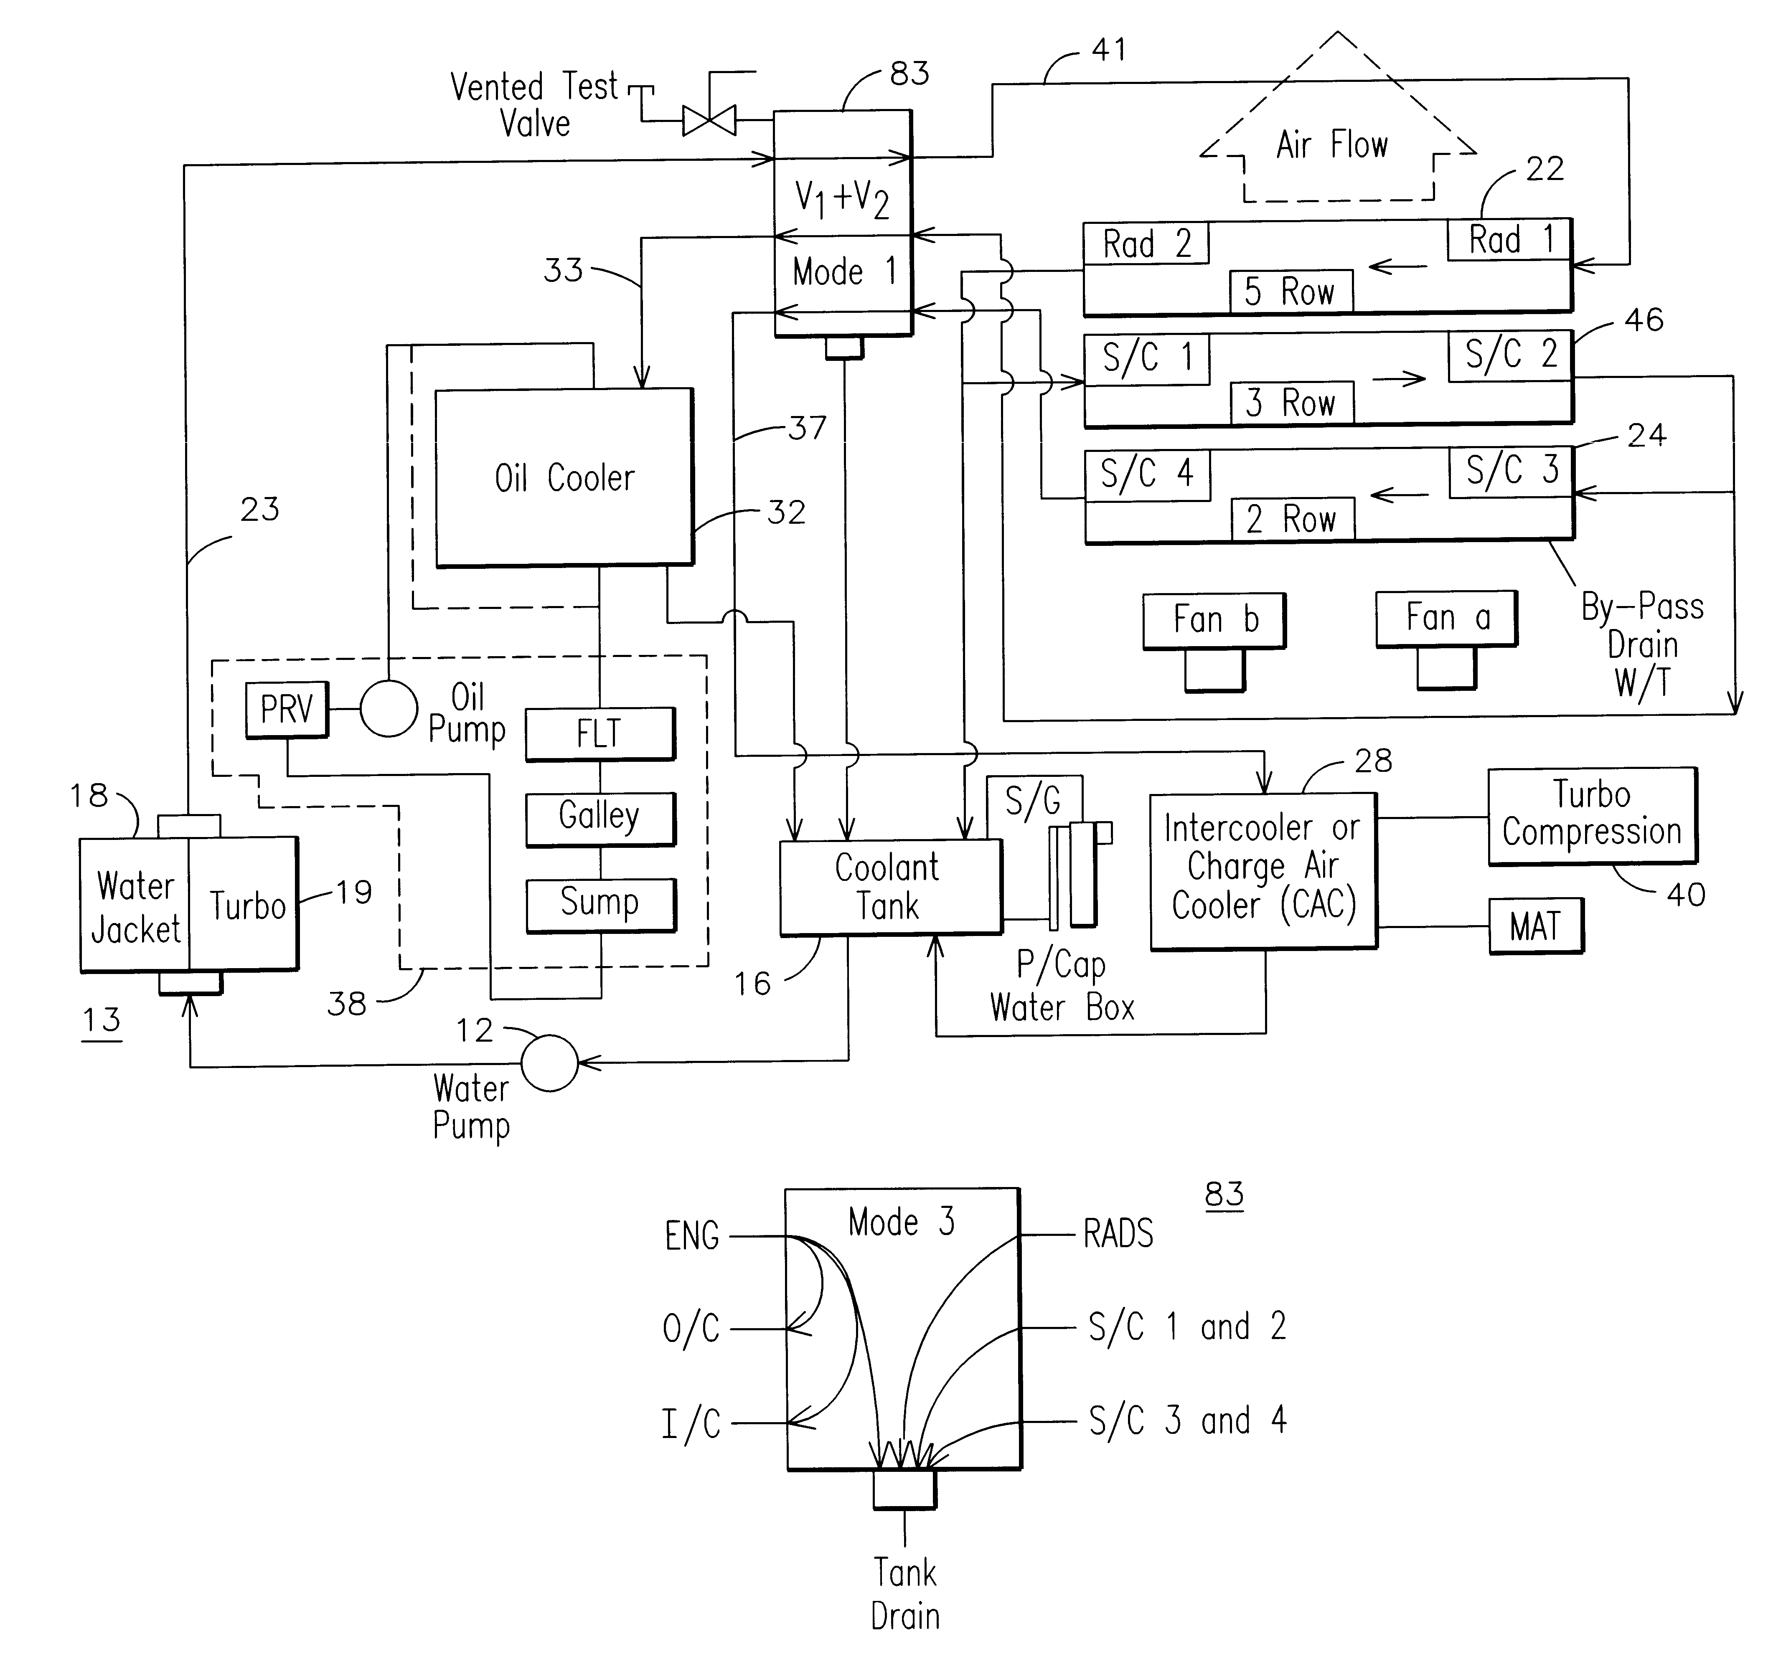
Flow control

Slide 47
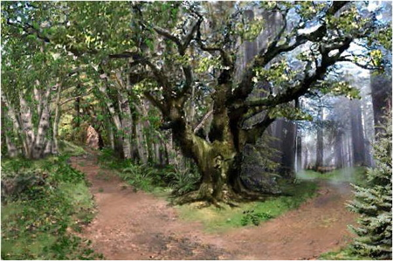
Conditionals

Slide 48
Conditionals

Slide 49
Conditionals
if condition
do this stuff
end
if condition
do this stuff
else
do this stuff
end
if condition
do this stuff
elseif condition
do this stuff
else
do this stuff
end

Slide 50
Conditionals
if condition
do this stuff
end
condition should evaluate to logical true or false. examples:
x > 5
y == 5
strcmp(subject,’S01’)

Slide 51
function isItBigger(x,y)
% will decide if x is bigger than y
if x > y
fprintf('Yes, x is bigger than y.\n');
else
fprintf('No, x is not bigger than y.\n');
end
>> isItBigger(3,4)
No, x is not bigger than y.
>> isItBigger(8,4)
Yes, x is bigger than y.
function isItNine(x)
% will decide if x is equal to 9
if x = 9
fprintf(’It is nine!\n');
else
fprintf('No, its not nine.\n');
end
function isItNine(x)
% will decide if x is equal to 9
if x == 9
fprintf(’It is nine!\n');
else
fprintf('No, its not nine.\n');
end

Slide 52
Nested conditionals
function fruit = pickAFruit(color,size)
% choose a fruit based on color and size
% color is a string, and size is a double representing weight in grams
if strcmp(color,’red’)
if size < 10
fruit = ‘apple’;
else
fruit = ‘watermelon’;
end
elseif strcmp(color,’yellow’)
fruit = ‘banana’;
else
fruit = ‘unknown’;
end

Slide 53
Code repetition

Slide 54
For loops
counter variable
function doLoop()
%do a loop
for i = 1:10
j = sqrt(i);
fprintf(‘The square root of %d is: %.2f\n’,i,j);
end
range of values for counter to take on
code to be repeated
>> doLoop()
The square root of 1 is 1.00
The square root of 2 is 1.41
The square root of 3 is 1.73
The square root of 4 is 2.00
The square root of 5 is 2.24
The square root of 6 is 2.45
The square root of 7 is 2.65
The square root of 8 is 2.83
The square root of 9 is 3.00
The square root of 10 is 3.16

Slide 55
For loops
function doLoop()
%do a loop
listOfPeople = {‘Fred’,’Mary’,’Laura’};
for i = 1:length(listOfPeople)
name = listOfPeople{i};
fprintf(‘Person number %d is %s\n’,i,name);
end
>> doLoop()
Person number 1 is Fred
Person number 2 is Mary
Person number 3 is Laura

Slide 56
Matlab’s Anti-loop bias
What in many other programming languages can only be done with loops, Matlab can often do with vectors

Slide 57
Matlab’s Anti-loop bias
Loop version:
x = .01;
for k = 1:1001
y(k) = log10(x);
x = x + .01;
end
Vector version:
x = .01:.01:10;
y = log10(x);
Vector version is faster, more efficient, and more Matlab-y
However, do not be afraid of using loops

Slide 58
While loops
while condition
do this stuff
end

Slide 59
While loops
function doLoop()
%do a loop
x = 0;
while x < 10
y = x^2;
fprintf(‘%d squared is %d\n’,x,y);
x = x + 1;
end
>> doLoop()
0 squared is 0
1 squared is 1
2 squared is 4
3 squared is 9
4 squared is 16
5 squared is 25
6 squared is 36
7 squared is 49
8 squared is 64
9 squared is 81

Slide 60
While loops
Infinite loops
function doLoop()
%do a loop
x = 0;
while 1
x = x + 1;
fprintf(‘x is %d\n’,x);
end

Slide 61
While loops
Breaking loops
function doLoop()
%do a loop
x = 0;
while 1
x = x + 1;
fprintf(‘x is %d\n’,x);
if sqrt(x) == 5
break;
end
end
end the loop, regardless of whether condition is still true

Slide 62
Working with files
Saving and loading Matlab variables to and from .mat files does not require any special file handling, just use save() and load()
However, if you want to read another kind of file, or create a file that can be read outside of Matlab, you must deal with files directly

Slide 63
Working with files
Introducing fopen() and fclose()
General plan for working with files:
fopen()
<read from file or write to file>
fclose()

Slide 64
Opening files
number returned by fopen which you will use to refer to this file
fid = fopen(filename, permission)
string with name of file or full path to file if it’s not in the current directory
string containing code that determines what Matlab is allowed to do with this file

Slide 65
Opening files
Permission codes
‘r’ open file for reading
‘w’ open file for writing (will create or overwrite)
‘a’ append data to file (will create if doesn’t already exist)

Slide 66
Writing to files
>> myFileID = fopen('testfile.txt','w')
myFileID =
3
>> x = 100;
>> fprintf(myFileID,'X is equal to %d\n',x);
>> fclose(myFileID);
>> fopen('/usr/bin/test.txt','w')
ans =
-1
If fopen() returns -1 then it has failed to open the file

Slide 67
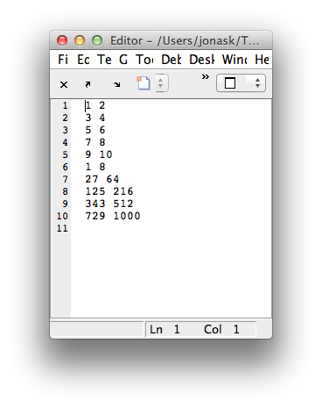
Writing to files
>> x = [1:10];
>> y = x .^3;
>> myExponentsFile = fopen('e.txt','w');
>> fprintf(myExponentsFile,'%d %d\n',[x;y]);

Slide 68
Writing to files
Other ways to write to files:
csvwrite()
dlmwrite()

Slide 69
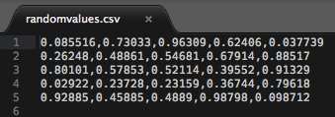
Writing to files
>> x = rand(5)
x =
0.0855 0.7303 0.9631 0.6241 0.0377
0.2625 0.4886 0.5468 0.6791 0.8852
0.8010 0.5785 0.5211 0.3955 0.9133
0.0292 0.2373 0.2316 0.3674 0.7962
0.9289 0.4588 0.4889 0.9880 0.0987
>> csvwrite('randomvalues.csv',x)
>> clear all
>> x = csvread('randomvalues.csv')
x =
0.0855 0.7303 0.9631 0.6241 0.0377
0.2625 0.4886 0.5468 0.6791 0.8852
0.8010 0.5785 0.5211 0.3955 0.9133
0.0292 0.2373 0.2316 0.3674 0.7962
0.9288 0.4588 0.4889 0.9880 0.0987

Slide 70
Reading from text files
textscan()
fgetl()
dlmread()
csvread()

Slide 71
Reading from text files
>> help textscan
textscan Read formatted data from text file or string.
C = textscan(FID,'FORMAT') reads data from an open text file identified
by FID into cell array C. Use FOPEN to open the file and obtain FID.
The FORMAT is a string of conversion specifiers enclosed in single
quotation marks. The number of specifiers determines the number of
cells in the cell array C. For more information, see "Format Options."

Slide 72
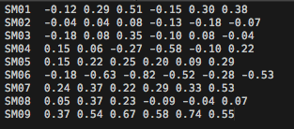
Reading from text files
Contents of "log.txt":
>> logFID = fopen('log.txt');
>> data = textascan(logFID,'%s %f %f %f %f %f %f')
data =
Columns 1 through 5
{9x1 cell} [9x1 double] [9x1 double] [9x1 double] [9x1 double]
Columns 6 through 7
[9x1 double] [9x1 double]

Slide 73
Reading from text files
>> subjectcodes = data{1}
subjectcodes =
'SM01'
'SM02'
'SM03'
'SM04'
'SM05'
'SM06'
'SM07'
'SM08'
'SM09'
>> fclose(logFID);
>>

Slide 74
The PsychToolbox

Slide 76
PsychToolbox (PTB)
A set of Matlab functions written by some vision researchers.
Not written by Mathworks.
Mature code: started in 1995, current version is PTB-3
Brainard, D. H. (1997) The Psychophysics Toolbox, Spatial Vision 10:433-436

Slide 77
Testing your PTB installation
>> PsychtoolboxVersion
ans =
3.0.11 - Flavor: beta - Corresponds to SVN Revision 4030 but is *locally modified* !
For more info visit:
https://github.com/Psychtoolbox-3/Psychtoolbox-3
>> UpdatePsychtoolbox
>>
>> help PsychDemos
>>
>> KbDemo

Slide 78
Before you start
Highly recommended custom function to clear the screen:
function cls()
clear Screen;
end

Slide 79
Before you start
>> ScreenTest
PTB-INFO: Connection to Psychtoolbox kernel support driver instance #0 (Revision 0) established.
PTB-INFO: Connection to Psychtoolbox kernel support driver instance #1 (Revision 0) established.
PTB-INFO: Switching to kernel driver instance #1 in hybrid graphics system, assuming i am attached to discrete non-Intel GPU.
***** ScreenTest: Testing Screen 0 *****
PTB-INFO: This is Psychtoolbox-3 for Apple OS X, under Matlab 64-Bit (Version 3.0.11 - Build date: Jul 8 2013).
PTB-INFO: Type 'PsychtoolboxVersion' for more detailed version information.
PTB-INFO: Most parts of the Psychtoolbox distribution are licensed to you under terms of the MIT License, with
PTB-INFO: some restrictions. See file 'License.txt' in the Psychtoolbox root folder for the exact licensing conditions.
PTB-INFO: Deficient Apple OS/X 10.7 or later detected: Would use fragile CoreVideo timestamping as fallback,
PTB-INFO: if beamposition timestamping would not work. Will try to use beamposition timestamping if possible.
PTB-INFO: OpenGL-Renderer is NVIDIA Corporation :: NVIDIA GeForce GT 330M OpenGL Engine :: 2.1 NVIDIA-8.12.47 310.40.00.05f01
PTB-INFO: Renderer has 512 MB of VRAM and a maximum 487 MB of texture memory.
PTB-INFO: VBL startline = 1050 , VBL Endline = 1079
PTB-INFO: Measured monitor refresh interval from beamposition = 16.699159 ms [59.883255 Hz].
PTB-INFO: Will use beamposition query for accurate Flip time stamping.
PTB-INFO: Measured monitor refresh interval from VBLsync = 16.672991 ms [59.977240 Hz]. (54 valid samples taken, stddev=0.198526 ms.)
PTB-INFO: Small deviations between reported values are normal and no reason to worry.
PTB-INFO: Support for fast OffscreenWindows enabled.
***** ScreenTest: Done With Screen 0 *****

Slide 80
Installing the kernel driver
On OSX there is a kernel extension (.kext) that you can install to make screen timing more precise
type help PsychtoolboxKernelDriver for instructions on how to install (basically you just unzip the kernel driver into the right system folder)

Slide 81
The Screen command
Screen() is the heart of Psychtoolbox
>> help Screen
Screen is a MEX file for precise control of the video display. Screen has
many functions; type "Screen" for a list:
Screen
For explanation of any particular screen function, just add a question
mark "?". E.g. for 'OpenWindow', try either of these equivalent forms:
Screen('OpenWindow?')
Screen OpenWindow?
All the Screen Preference settings are documented together:
Screen Preference?
MEX = "Matlab Executable"
A file written in another language like C that can be called as a Matlab function

Slide 82
The Screen command
>> Screen
Usage:
% Activate compatibility mode: Try to behave like the old MacOS-9 Psychtoolbox:
oldEnableFlag=Screen('Preference', 'EmulateOldPTB', [enableFlag]);
% Open or close a window or texture:
[windowPtr,rect]=Screen('OpenWindow',windowPtrOrScreenNumber [,color] [,rect] [,pixelSize] [,numberOfBuffers] [,stereomode] [,multisample][,imagingmode][,specialFlags][,clientRect]);
[windowPtr,rect]=Screen('OpenOffscreenWindow',windowPtrOrScreenNumber [,color] [,rect] [,pixelSize] [,specialFlags] [,multiSample]);
textureIndex=Screen('MakeTexture', WindowIndex, imageMatrix [, optimizeForDrawAngle=0] [, specialFlags=0] [, floatprecision=0] [, textureOrientation=0] [, textureShader=0]);
oldParams = Screen('PanelFitter', windowPtr [, newParams]);
Screen('Close', [windowOrTextureIndex or list of textureIndices/offscreenWindowIndices]);
Screen('CloseAll');
% Draw lines and solids like QuickDraw and DirectX (OS 9 and Windows):
currentbuffer = Screen('SelectStereoDrawBuffer', windowPtr [, bufferid] [, param1]);
Screen('DrawLine', windowPtr [,color], fromH, fromV, toH, toV [,penWidth]);
Screen('DrawArc',windowPtr,[color],[rect],startAngle,arcAngle)
Screen('FrameArc',windowPtr,[color],[rect],startAngle,arcAngle[,penWidth] [,penHeight] [,penMode])
Screen('FillArc',windowPtr,[color],[rect],startAngle,arcAngle)
Screen('FillRect', windowPtr [,color] [,rect] );
Screen('FrameRect', windowPtr [,color] [,rect] [,penWidth]);
Screen('FillOval', windowPtr [,color] [,rect] [,perfectUpToMaxDiameter]);
Screen('FrameOval', windowPtr [,color] [,rect] [,penWidth] [,penHeight] [,penMode]);
Screen('FramePoly', windowPtr [,color], pointList [,penWidth]);

Slide 83
The Screen command
>> Screen DrawLine?
Usage:
Screen('DrawLine', windowPtr [,color], fromH, fromV, toH, toV [,penWidth]);
Draw a line. "color" is the clut index (scalar or [r g b a] vector) that you
want to poke into each pixel; default produces black. "fromH" and "fromV" are
the starting x and y positions, respectively. "toH" and "toV" are the ending x
and y positions, respectively. Default "penWidth" is 1.
See also: DrawLines

Slide 84
Double buffering
INVISIBLE
VISIBLE
"Back" screen/buffer
"Front" screen/buffer

Slide 85
Double buffering
draw on back buffer
A
"Back" screen/buffer
"Front" screen/buffer

Slide 86
Double buffering
draw on back buffer
A
"Back" screen/buffer
Swap or "Flip"
buffers
"Front" screen/buffer

Slide 87
Double buffering
Note that flipping clears the new back buffer
A
"Back" screen/buffer
Swap or "Flip"
buffers
"Front" screen/buffer

Slide 88
Double buffering
Draw next frame on back buffer
B
A
"Back" screen/buffer
"Front" screen/buffer

Slide 89
Double buffering
Flip again
B
"Back" screen/buffer
"Front" screen/buffer

Slide 90
Using the Screen command
Whenever you draw to the screen in PTB, you are drawing to the back buffer
You will not see anything you've drawn until you "Flip" the buffers
This separates drawing and arranging time from presentation time – you can wait until the precise moment you want everything to appear and pull the trigger (Flip)

Slide 91
Using the Screen command
Opening the screen
[windowPtr,rect]=Screen('OpenWindow',ScreenNumber)
returns a number that we will use to refer to this screen in future commands
which screen you want to open (you may have multiple monitors)
returns a rectangle (a vector of four numbers) that describe the dimensions of the screen

Slide 92
[windowPtr,rect]=Screen('OpenWindow',ScreenNumber)
which screen you want to open (you may have multiple monitors)
Slight OS difference here!
For all platform differences, see http://psychtoolbox.org/PlatformDifferences
>> Screen('Screens')
ans =
0 1
MAC OS X:
0 is the main display (with the menubar) and 1 is the first external display
WINDOWS:
0 refers to all displays together, then 1 is the main monitor and 2-x are externals
>> max(Screen('Screens'))
ans =
1

Slide 93
[windowPtr,rect]=Screen('OpenWindow',ScreenNumber)
returns a rectangle (a vector of four numbers) that describe the dimensions of the screen
>> rect
rect =
0 0 1680 1050
width
height
(0,0)
x
y
(1680,1050)

Slide 94
Using Screen
function drawSomething()
clear Screen;
end

